Slide 1
Statistical Inference: Case Study Using Python

Slide 2
Session Pedagogy
Data Understanding
Business Objective given
Class Discussion to
Conceptualize the Output
Approach the Analysis in R
Participants Create the R code independently
Final code and output shown
Notes:
How to detect outliers<-Boxplot

Slide 3
Background
Large FMCG company
Pan country presence
3 business lines- Ice Cream, Chocolates and Cakes-Biscuits
Large amount of data is available

Slide 4
Supply Chain
Company
Wholesalers
Retailers
Consumers
‘Customer’ in our case study

Slide 5
Data Snapshots
Customer Profile Data
NPS Data
Market survey data is available for 107 customers(NPS Data). The survey
recorded ‘Net promoter Score’ .
Net Promoter Scores are based on response to single question (0-10 scale)
How likely is it that you would recommend [brand] to a friend or colleague?

Slide 6
Get Started
Import data sets: CUST_PROFILE and NPSDATA.
CUST_PROFILE data has custid and region.
NPSDATA has custid and Net Promoter Score measured on 0-10 scale.
Import and check dimensions and number of unique customers in each data set.
Merge two data sets.

Slide 7
Get Started- Python codes and output
custprofile = pd.read_csv("CUST_PROFILE.csv")
npsdata = pd.read_csv('NPSDATA.csv')
custprofile.shape
[1] 15001 2
npsdata.shape
[1] 107 2
len(custprofile)
[1] 15001
len(npsdata)
[1] 107

Slide 8
Get Started- Python codes and output Merging Two Data Sets
npsregion = pd.merge(npsdata,custprofile,on = 'CUSTID',how = 'left')
head(npsregion)
CUSTID NPS REGION
1 10155 8 South
2 10211 7 West
3 10271 7 North
4 10477 9 South
5 10535 8 West
6 10564 7 South

Slide 9
1. Assessing Net Promoter Score
What is the Net Promoter Score on an average?
Suggestion: Use median as well as mean since the measurement scale is ordinal.(median is better measure)
Describe NPS graphically.
Suggestion: Use Box-Whisker plot or bar chart to plot median

Slide 10
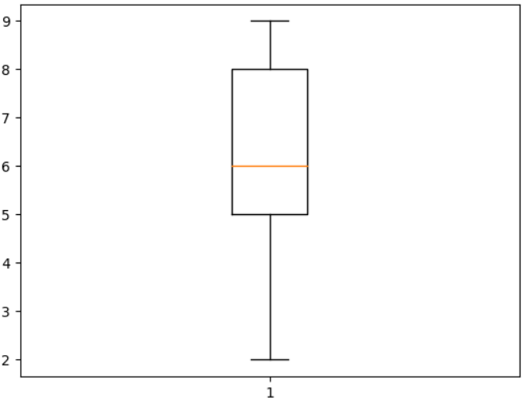
Assessing Net Promoter Score Python Code and Output
> len(npsregion)
[1] 107
> npsregion['NPS'].mean().round(2)
[1] 6.2
> npsregion['NPS'].median().round(2)
[1] 6
import matplotlib.pyplot as plt
plt.boxplot(npsregion['NPS'])

Slide 11
2. Is NPS significantly more than '6'?
Which test to be used?
Can we assume 'Normality' of the distribution?
Is NPS significantly more than '6'?

Slide 12
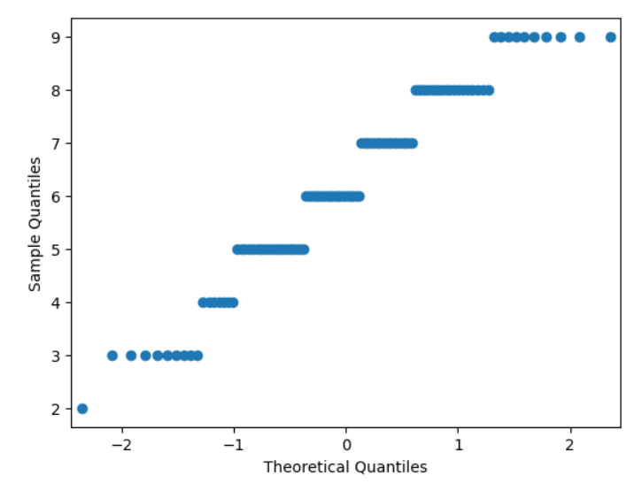
Can we assume 'Normality' of the distribution? Python Code and Output
plt.boxplot(npsregion['NPS'])
from statsmodels.graphics.gofplots import qqplot
qqplot(npsregion['NPS'])
from scipy.stats import shapiro
statistic, p_value = shapiro(npsregion['NPS'])
Shapiro-Wilk Test Statistic = 0.94709
p-value = 0.000326
from statsmodels.stats.diagnostic import lilliefors
statistic, p_value = lilliefors(nps_data)
Lilliefors Test Statistic = 0.12501
p-value = 0.000999

Slide 13
Is NPS significantly more than '6’? Python Code and Output
from scipy.stats import wilcoxon
mu = 6
statistic, p_value = wilcoxon(npsregion['NPS'] - mu, alternative='greater')
One-Sample Wilcoxon Test Statistic = 2166
p-value = 0.0977
Conclusion: Do not reject H0. Average NPS is not significantly more
than '6'.

Slide 14
3. Compare NPS Region-wise
Which region has on an average highest NPS?
Suggestion: Use mean as well as median.
Is region wise difference in NPS significantly different?
Present region wise NPS graphically.

Slide 15
Which region has on an average highest NPS? Python Code and Output
npsregion.groupby('REGION')['NPS'].mean()
REGION NPS
1 East 6.250000
2 North 6.208333
3 South 6.057143
4. West 6.321429
npsregion.groupby('REGION')['NPS'].median()
REGION NPS
1 East 6
2 North 6
3 South 6
4 West 7

Slide 16
Is region wise difference in NPS significantly different? Python Code and Output
from scipy.stats import kruskal
nps_data = npsregion['NPS']
regions = npsregion['REGION']
statistic, p_value = kruskal(*[nps_data[regions == region] for region in regions.unique()])
Kruskal-Wallis Test Statistic= 0.52336
p-value = 0.9137
Region wise difference in NPS is not significant.

Slide 17
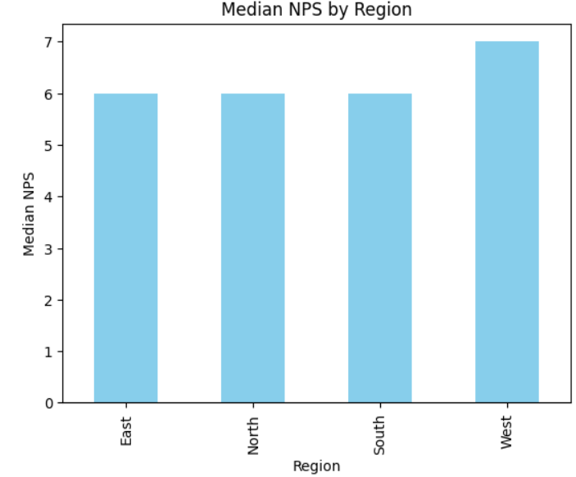
Median NPS -Bar Diagram
med = npsregion.groupby('REGION')['NPS'].median()
med.plot(kind='bar', color='skyblue’)
plt.xlabel('Region')
plt.ylabel('Median NPS')
plt.title('Median NPS by Region')

Slide 18
4. Detractors vs. Non-detractors
What percentage of customers are 'detractors'?
Detractor: NPS score of less than or equal to 6
Suggestion: Derive a new variable 'detractor' having values 'YES' or 'NO'.
Is percentage of detractors significantly greater than 40%?

Slide 19
What percentage of customers are 'detractors'? Python Code and Output
import numpy as np
npsregion['detractor'] = np.where(npsregion['NPS'] <= 6, 'YES', 'NO')
table_detractor = pd.value_counts(npsregion['detractor'])
table_detractor
detractor
NO 48
YES 59
proportion_detractor = npsregion['detractor'].value_counts(normalize=True)
proportion_detractor
detractor
NO 0.4485981
YES 0.5514019
55% are detractors

Slide 20
Is percentage of detractors significantly greater than 40%? Python Code and Output
from statsmodels.stats.proportion import proportions_ztest
count_yes = table_detractor.get('YES', 0)
total_count = sum(table_detractor)
expected_proportion = 0.4
statistic, p_value = proportions_ztest(count_yes, total_count, expected_proportion, alternative='larger’)
Z-test Statistic: 3.1489
P-value: 0.0008194
NOTE : Answers don’t match with R.
% of detractors significantly more than 40%.

Slide 21
5. Association between region and detractor(Y/N)
Summarize 'detractor' by region.
Test for association between region and detractor(Y/N)
Suggestion: Use 'gmodels' package.

Slide 22
Testing Association Python Code and Output
cont_table = pd.crosstab(npsregion['REGION'], npsregion['detractor'])
from scipy.stats import chi2_contingency
chi2_contingency(cont_table)
Chi2ContingencyResult(statistic=1.711051839521119, pvalue=0.634479520420212, dof=3, expected_freq=array([[ 8.97196262, 11.02803738], [10.76635514, 13.23364486], [15.70093458, 19.29906542], [12.56074766, 15.43925234]]))
No association between Region and ‘detractor’

Slide 23
THANK YOU!

